Slide 1
Descriptive statistics
Week 7

Slide 2
Recap
In Week 5 we discussed what needs to be considered to set up a study
  Create Test Plan
  Test Material preparation
    To inform users
    To instruct users
    To instruct moderators
    To collect data at various stages of the study, pre-during-post
  Ethical considerations
This week we will look
  Basic concepts of statistical analysis
  Preparing data for analysis
  Descriptive statistics
    Measures of central tendency
    Measures of variability
  Which graph

Slide 3
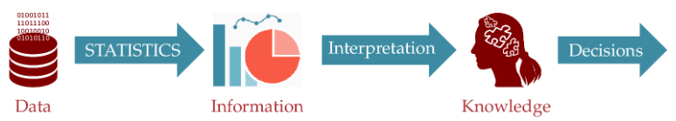
Basic statistical concepts

Slide 4
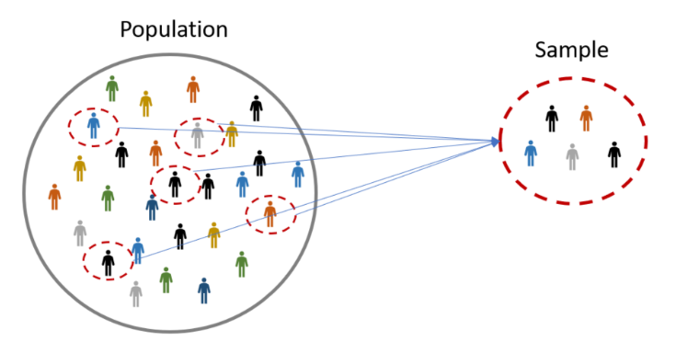
Basic Statistics Concepts & Terminology
A population is the entire group that you want to draw conclusions about.
A sample is a specific group that you will collect data from (a smaller and more manageable representation of a larger group)
In research, a population doesn’t always refer to people. It can mean a group containing elements of anything you want to study, such as objects, events, organisations, countries, species, or organisms.
e.g. User Preference of the 20 students in this seminar
e.g. User preference (generalisation)

Slide 5
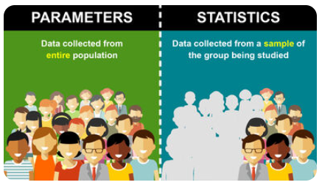
Basic Statistics Concepts & Terminology
Parameters are based on data collected from an entire population. This means that every member of the group is accounted for in the results. Parameters provide descriptive data specific to a particular population.
Statistics are based on data collected from a sample of the group being studied.

Slide 6
There are two families of statistics
Descriptive statistics
Organise
Inferential statistics
Generalise from sample to population
Summarise
Simplify
Describe and present data
Hypothesis testing
Make predictions
Notes:
Descriptive statistics
Descriptive statistics are used to summarise and describe data (information that has been collected).
Data are usually organised and presented in tables or graphs that summarise information, such as histograms, pie charts, bars or scatterplots.
Descriptive statistics are only descriptive and, thus, do not involve generalising beyond the data that has been collected.
Examples of descriptive statistics are the average age of university students, or the number of female and male students undertaking a Health Sciences degree.
Inferential statistics:
With Inferential statistics, data are usually collected from a sample; that is, a smaller representative subset of the larger population we wish to investigate.
Inferential statistics use the theory of probability to investigate whether patterns found in the sample of study can be generalised to the wider population where the sample comes from.
Inferential statistics aim to test hypotheses and explore relationships between variables, and can be used to make predictions about the population.
Inferential statistics are used to draw conclusions and inferences; that is, to make valid generalisations from samples.
Examples of inferential statistics are statistical techniques to explore the relationship between variables (e.g. correlation coefficients). These techniques show us whether two variables are related: for instance, whether there is a relationship between stress levels and academic results.

Slide 7
Preparing data for statistical analysis
Clean up the collected data
Organise data
Descriptive statistics
Inferential statistics

Slide 8
Clean up the collected data
Screen the data for possible errors
    “To err is human”
  If the age of a participant is entered as “223,” you can easily conclude that there is something wrong
  For automatically collected data, error checking usually boils down to time consistency issues or whether the performance is within a reasonable range.
  In case you collect data from multiple channels, ensure that data is synchronized and correctly grouped together
  What do we do with errors? Possibly we remove them.

Slide 9
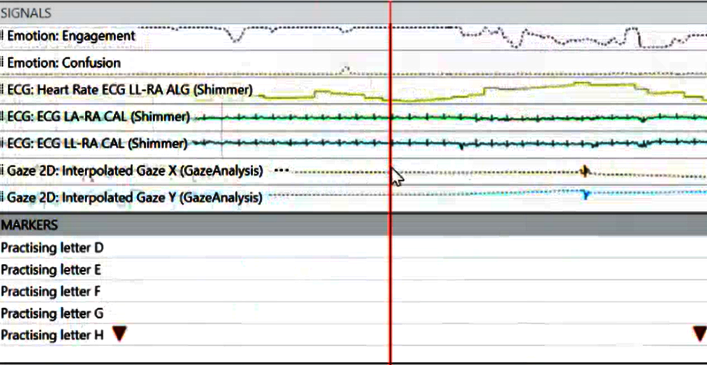

Slide 10
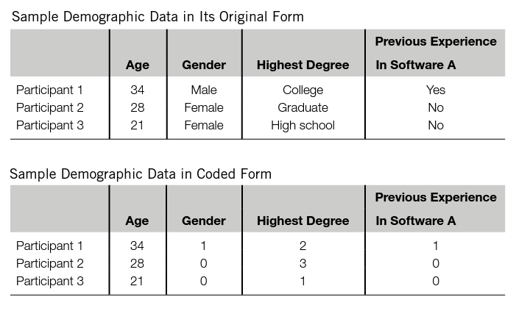
Coding data
The original data collected need to be coded before any statistical analysis can be conducted

Slide 11


Identify the type of data
Variable is a property or characteristic measured in the population of individuals or objects
Qualitative variables - they measure non-numeric qualities.
  Nominals: There is no natural order between its categories. Example: The hair colour or the gender.
  Ordinals: data are ordered groups or categories (the data can be organised in a meaningful order). Example: The education level.
Quantitative variables - they measure numeric quantities.
  Interval (discrete): are ordered data where the differences between the values are meaningful (equal intervals and usually integers). There is no absolute 0.
    Example: Temperature (0 does not mean the absence of temperature).
  Ratio (continuous): Ratio is the same as interval but they can take the value of an absolute 0.
    Example: The height, weight or age of a person.
breed
size
height
weight

Slide 12
Examples of interval data in UX context
User Satisfaction Ratings on a Likert Scale: If users rate their satisfaction on a scale from 1 to 7 (where 1 = "Very dissatisfied" and 7 = "Very satisfied"), a rating of 1 or 0 does not mean the absence of satisfaction but rather a low level on an arbitrary scale. Even if a 0 rating is included, it doesn’t represent an "absolute" lack of satisfaction.
System Usability Scale (SUS) Scores: The SUS score is a standardized usability metric ranging from 0 to 100. A score of 0 does not indicate the complete absence of usability but represents a very poor usability experience on a specific scale. The 0 point is arbitrary and relative, not absolute.
Task Difficulty Ratings: When users rate task difficulty on a scale, such as 1 to 5 (1 = "Very easy" to 5 = "Very difficult"), a rating of 1 doesn’t mean the task has no difficulty; it just represents a low level on the difficulty scale. Here, 0 would not indicate an absence of difficulty, only a very low perception.
Mental Effort Ratings: If users rate how mentally demanding a task was on a scale from 0 to 10, a rating of 0 does not mean the task required no mental effort in an absolute sense; it just means very little effort. It’s an arbitrary scale for gauging perceived effort, not an absolute measurement.
Confidence Ratings: If users rate their confidence in completing a task on a scale from 1 to 7, a score of 1 doesn’t mean an absence of confidence but represents a low point on a set scale. Zero, if it’s an option, would not mean "no confidence" in absolute terms but rather minimal confidence.

Slide 13
Data
Statistical variables
Qualitative
Quantitative
Nominal
Ordinal
Interval
Ratio
The attribute can be named
In UX
Gender
Type of users (OS/Windows)
Users in different geographical locations
The attribute can be ordered/organized in a certain way
Study level
In UX
Ranked data (rank the 3 designs from 1st preference, 2nd preference, 3rd preference)
Ordered data where the differences between the values are meaningful
There is an absolute 0
In UX
Time
Score
Number of clicks/errors/steps
Ordered data where the differences between the values are meaningful
No absolute 0
In UX
Scale values
Usability score
Mental effort
Confidence rating

Slide 14
Types of data
 | Nominal | Ordinal | Interval | Ratio
Categories | ☑ | ☑ | ☑ | ☑
Rank order |  | ☑ | ☑ | ☑
Equal spacing |  |  | ☑ | ☑
True zero |  |  |  | ☑

Slide 15
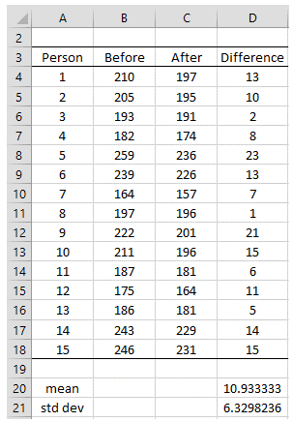
Organising data
Groups | Data
1 | 123
1 | 145
1 | 143
1 | 154
1 | 102
1 | 98
1 | 89
1 | 112
1 | 107
1 | 123
2 | 133
2 | 155
2 | 157
2 | 158
2 | 110
2 | 112
2 | 94
2 | 123
2 | 116
2 | 133
Statistical and other data-processing software normally has predefined requirements for how data should be laid out for specific statistical analysis.
In SPSS, for example, when running an independent-samples t test to compare two groups of data, the data of the two groups need to be listed in the same column.
In contrast, when running a paired-samples t test to compare two means, the two groups of data need to be laid out parallel to each other in two separate columns.
Similarly, other statistical methods such as ANOVA, repeated measures, and correlation all have different data organization requirements that need to be followed closely.
Person | Before | After
1 | 123 | 133
2 | 145 | 155
3 | 143 | 157
4 | 154 | 158
5 | 102 | 110
6 | 98 | 112
7 | 89 | 94
8 | 112 | 123
9 | 107 | 116
10 | 95 | 114

Slide 16
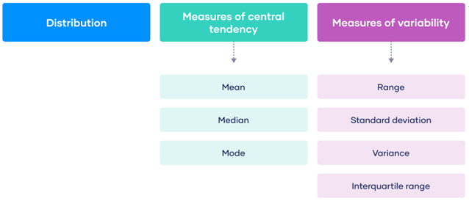
Descriptive statistics
Notes:
After the collected data is cleaned up, you may want to run a number of basic descriptive statistical tests to understand the nature of your data set. For instance, you may want to know the range into which most of your data points fall; you may also want to know how your data points are distributed. The most commonly used descriptive measures include means, medians, modes, variances, standard deviations, and ranges.

Slide 17
The middle
In a dataset with thousands or even millions of data points, we are interested to know the middle
Where is the middle in the following case?
2 3 4 [ the middle is 3 and the distance between the end is equal]
2 6 [the middle value? Or the average]

Slide 18
Measures of Central Tendency
When we study a data set, we often want to find out where the bulk of the data is located.
In statistical terms, this characteristic is called the “central tendency.”
Various measures can be used to describe the central tendency of a data set, including the:
  Mean – average - the sum of all the numbers divided by the count of the numbers
  Median – middle – the middle value in the data set
  Mode – most common value

Slide 19


Measures of Central Tendency- Mean
Participant | 1 | 2 | 3 | 4 | 5
Reaction time (milliseconds) | 287 | 345 | 365 | 298 | 380
Calculate the mean
  First you add up the sum of all values
  Then you calculate the mean using the formula
  There are 5 values in the dataset, so n = 5.
Mean (x̄): 335 milliseconds

Slide 20


Measures of Central Tendency - Median
Participant | 1 | 2 | 3 | 4 | 5
Reaction time (milliseconds) | 287 | 345 | 365 | 298 | 380
To calculate the median
  Order the data
  The middle position is calculated using , where n = 5
  The median is the 3rd value in your ordered dataset.
Reaction time (milliseconds) | 287 | 298 | 345 | 365 | 380
Median: 345 milliseconds

Slide 21
Measures of Central Tendency - Mode
Ask 9 participants what type of mobile phone they have
  Apple iPhone [1]
  Samsung Galaxy [2]
  Google [3]
  Samsung Galaxy [4]
  Apple iPhone [3]
  Google [2]
Participant
1 | Apple iPhone | 1
2 | Samsung Galaxy | 2
3 | Google | 3
4 | Apple iPhone | 1
5 | Samsung Galaxy | 2
6 | Apple iPhone | 1
7 | Samsung Galaxy | 2
8 | Samsung Galaxy | 2
9 | Google | 3
Mode: Samsung Galaxy
The mode is most applicable to data from nominal data
For continuous variables or ratio levels of measurement, the mode may not be a helpful measure of central tendency. That’s because there are many more possible values than there are in a nominal or ordinal level of measurement. It’s unlikely for a value to repeat in a ratio level of measurement.

Slide 22
Measures of central tendency limitations
The measures of central tendency (mean – median – mode) are helpful to understand the data and are easy to calculate, but they have limitations.
Same middle but a different data set

Slide 23
Example
Data set 1
29
31
Data set 2
20
40
Data set 3
0
60
All same mean 30
But how do we describe how close or how far away the points are in the dataset?

Slide 24
Example
Is the information we get from the mean and the median and is it enough?
Data set 1
80 | 85 | 85 | 90 | 95
Data set 2
25 | 65 | 70 | 125 | 150
Mean | 87
Median | 85
Mean | 87
Median | 70

Slide 25
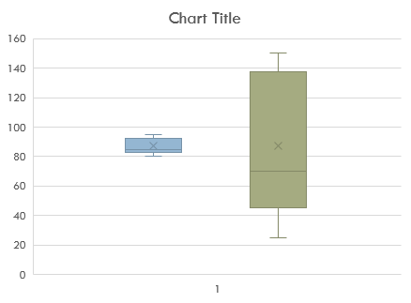
Example
The mean and the median look at the middle of the data set, but in order to look how spread the data is we can look at the edges of the dataset.
To better understand the data we need information about variability
Data set 1
80 | 85 | 85 | 90 | 95
Mean | 87
Median | 85
Data set 2
25 | 65 | 70 | 125 | 150
Mean | 87
Median | 70

Slide 26
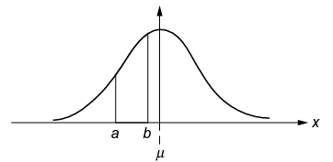
Measures of Variability/Spread
Measures in this group include:
  Range - the distance between the highest and lowest scores in the data set
  The variance is a measure of variability. It is calculated by taking the average of squared deviations from the mean. The square root of the variance is called the standard deviation. Both measures reflect variability in a distribution, but their units differ.
  As with range, higher variances or standard deviations indicate that the data set is more distributed.
  A commonly used method for describing the distribution of a data set is the normal distribution (explained later)
Notes:
Another important group of descriptive measures that we usually want to know is how much the data points deviate from the center of the data set. In other words, we want to know how spread out our data set is. Measures in this group include range, variances, and standard deviations. The range measures the distance between the highest and lowest scores in the data set. In the typing-speed data set of Section 4.2.1 , the range is 50 − 15 = 35. The larger the range, the more distributed the data set is. The variance of a data set is the mean of the squared distances of all the scores from the mean of the data set. The square root of the variance is called the standard deviation. As with range, higher variances or standard deviations indicate that the data set is more distributed. A commonly used method for describing the distribution of a data set is the normal distribution, a special bell-shaped distribution that can be defined by the mean and the standard deviation (see Figure 4.1 ). The pattern of normal distribution is very important and useful for data analysis since many attributes from various fields of study are distributed normally, such as the heights of a population, student grades, and various performance measures.

Slide 27


Measures of Variability - Range
Participant | 1 | 2 | 3 | 4 | 5
Reaction time (milliseconds) Group A | 85 | 90 | 85 | 80 | 95
Reaction time (milliseconds) Group B | 65 | 70 | 25 | 150 | 125
Calculate the range
  First, order the values from low to high to identify the lowest value (L) and the highest value (H).
  R= H-L
    R = range
    H = highest value
    L = lowest value
  Group A R = 95-80 = 15
  Group B R = 150-25 = 125
Reaction time (milliseconds) Group A | 80 | 85 | 85 | 90 | 95
Reaction time (milliseconds) Group B | 25 | 65 | 70 | 125 | 150
  Range - the distance between the highest and lowest scores in the data set

Slide 28
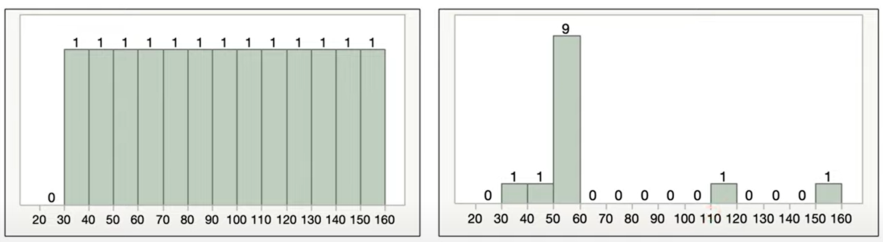


Range
outliers
R= 150-30-120
R= 150-30-120
Relying only on range could be misleading, as in this example the range is the same but the dataset distribution is very different

Slide 29
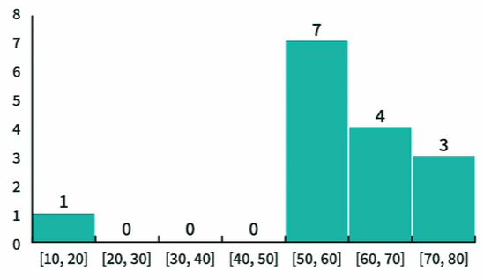
Measures of Variability– Standard Deviation
10
50
52
53
53
54
57
55
62
64
65
67
72
75
80
Range is a measure of variability, but it takes one rogue data point to exaggerate the size of the dataset’s range. This is why we look at the standard deviation
Task time completion scores Histogram
Notes:
One user here inflated the range

Slide 30
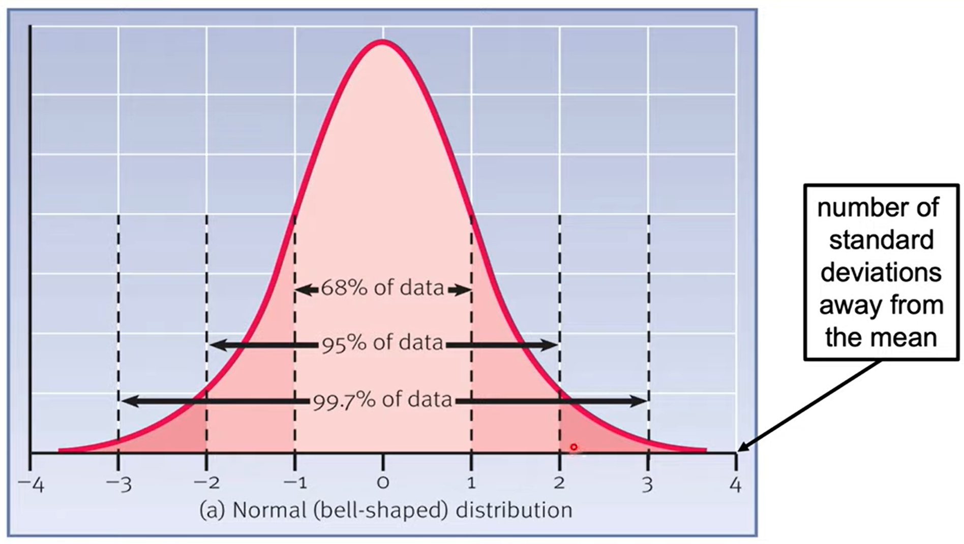
Measures of Variability– Standard Deviation
  The standard (or typical) amount that scores deviate from the mean
Notes:
Whenever you have a normal curve, a normally distributed set of data which is common in the world for things like weight, height, standard deviation has this interesting property of giving you information of what is common and what is not common. So 0 is where the mean is. If we go 1 standard deviation above or below the mean just because we know how standard deviation work, that 68% of people will fall within the range between -1 to 1. 95% of people between -2 to 2

Slide 31

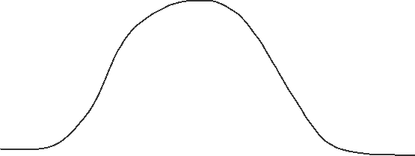
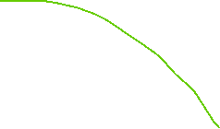
Example SD in UX context
The Average Clicks Per Second = 6.51
If you can do 5 click per second you belong in the 68% of the population that achieve this speed which is the norm
If you can do 12 click per second you belong in the 5% of the population that can click so fast!
1
3.5
5
6.51
7.5
10
14
68%
95%
99.7%

Slide 32


Measures of Variability– Standard Deviation
  The standard (or typical) amount that scores deviate from the mean
Population standard deviation
Sample standard deviation
    σ = population standard deviation
    Σ = sum of…
    X = each value
    μ = population mean
    N = number of values in the population
    s = sample standard deviation
    Σ = sum of…
    X = each value
    x = sample mean
    N = number of values in the population

Slide 33
Steps to calculate the Standard Deviation
Steps to calculate the standard deviation
  Step 1: Find the mean
  Step 2: Find each score’s deviation from the mean
  Step 3: Square each deviation from the mean
  Step 4: Find the sum of squares
  Step 5: Find the variance
  Step 6: Find the square root of the variance
  Bhandari, P. (May 25, 2022). How to Calculate Standard Deviation (Guide) | Formulas & Examples. Scribbr. Retrieved October 23, 2022, from https://www.scribbr.com/statistics/standard-deviation/

Slide 34
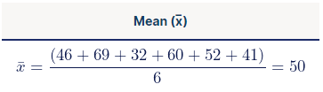
Step 1 to find SD
Data set
46 | 69 | 32 | 60 | 52 | 41
Step 1: Find the mean

Slide 35
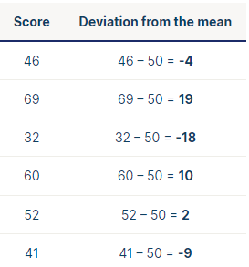
Step 2 to find SD
Data set
46 | 69 | 32 | 60 | 52 | 41
Step 2: Find each score’s deviation from the mean
  Subtract the mean from each score to get the deviations from the mean.
  Since x̅ = 50, here we take away 50 from each score.

Slide 36
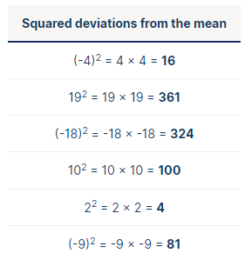
Step 3 to find SD
Data set
46 | 69 | 32 | 60 | 52 | 41
Step 3: Square each deviation from the mean
  Multiply each deviation from the mean by itself. This will result in positive numbers.

Slide 37

Step 4 to find SD
Data set
46 | 69 | 32 | 60 | 52 | 41
Step 4: Find the sum of squares
  Add up all of the squared deviations. This is called the sum of squares.

Slide 38
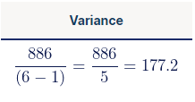
Step 5 to find SD
Measures of Variability– Variance
Data set
46 | 69 | 32 | 60 | 52 | 41
Step 5: Find the variance
  Divide the sum of the squares by n – 1 (for a sample) or N (for a population) – this is the variance.
  Since we’re working with a sample size of 6, we will use n – 1, where n = 6.
  The variance tells you how far each value lies from the mean.
  Variance is expressed in much larger units

Slide 39

Step 6 to find SD
Data set
46 | 69 | 32 | 60 | 52 | 41
Step 6: Find the square root of the variance
  To find the standard deviation, we take the square root of the variance
  From learning that SD = 13.31, we can say that each score deviates from the mean by 13.31 points on average
  Standard deviation is expressed in the same units as the original values

Slide 40
Variance vs SD
Both measures reflect variability in a distribution, but their units differ:
  Standard deviation is expressed in the same units as the original values (e.g., meters).
  Variance is expressed in much larger units (e.g., meters squared)
Since the units of variance are much larger than those of a typical value of a data set, it’s harder to interpret the variance number intuitively. That’s why standard deviation is often preferred as a main measure of variability.
However, the variance is more informative about variability than the standard deviation, and it’s used in making statistical inferences.

Slide 41
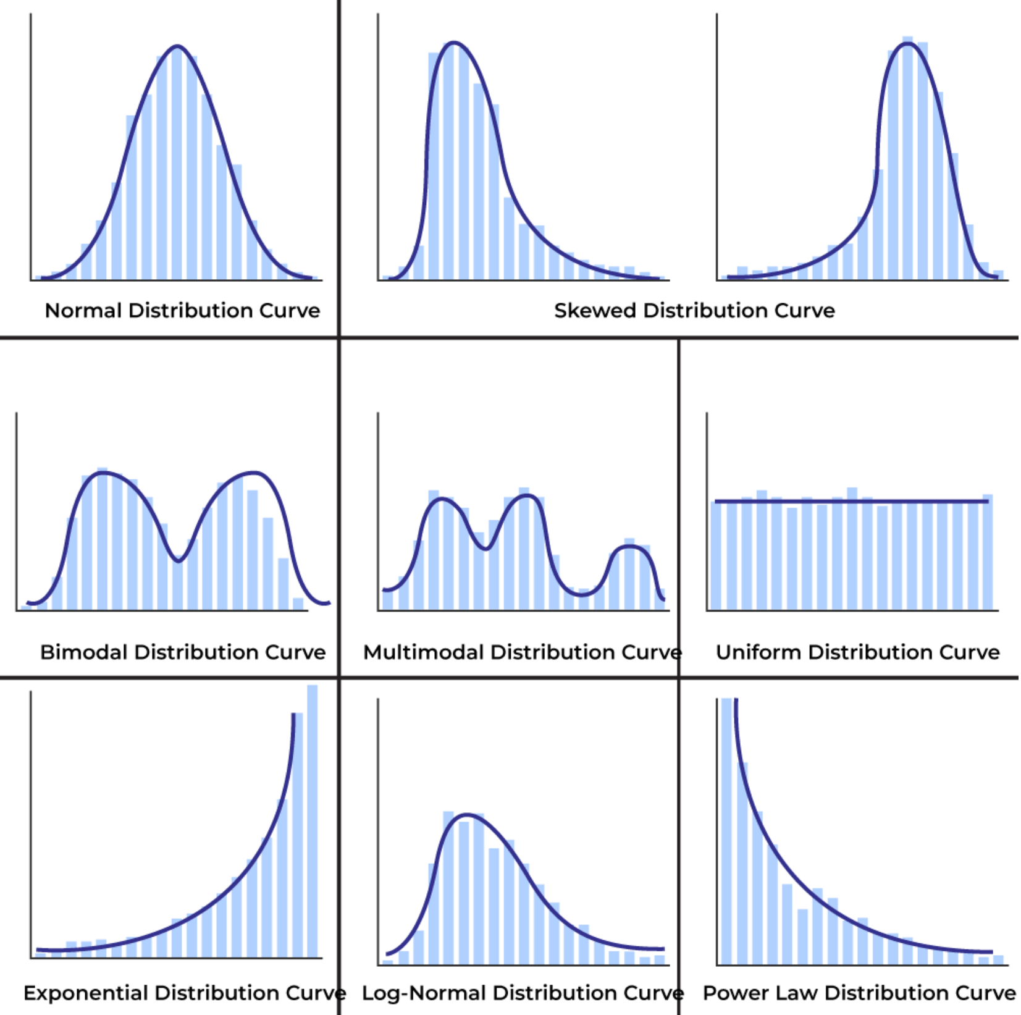
Normal Distribution

Slide 42
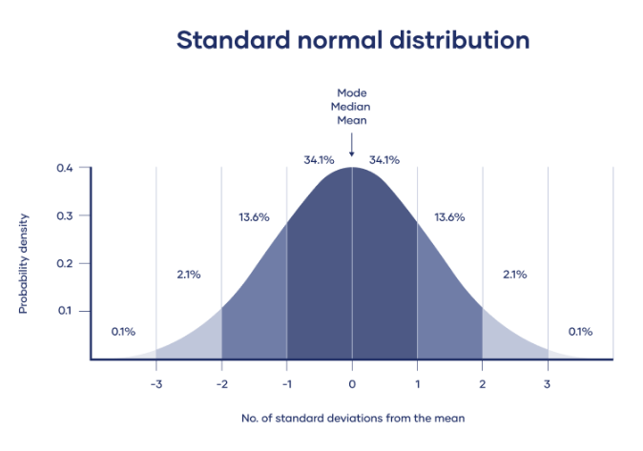
Normal distribution
The distribution of a data set is described by the normal distribution. Normal distributions have key characteristics that are easy to spot in graphs:
  The mean, median, and mode are all equal and located at the center of the distribution.
  About 68% of data falls within one standard deviation of the mean, 95% within two standard deviations, and 99.7% within three standard deviations.
  The shape is symmetrical, with the tails approaching but never quite reaching zero on either side.

Slide 43
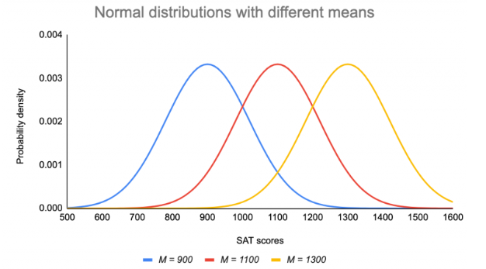
Standard normal distribution
The mean determines where the peak of the curve is centred. Increasing the mean moves the curve right, while decreasing it moves the curve left.

Slide 44
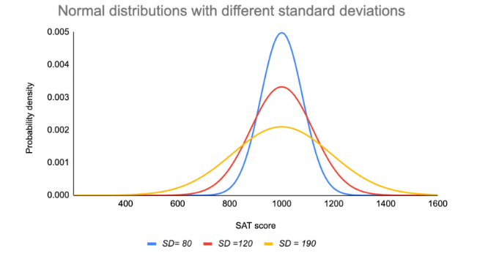
Standard normal distribution
The mean (M) ratings are the same for each group – it’s the value on the x-axis when the curve is at its peak. However, their standard deviations (SD) differ from each other.
The standard deviation reflects the dispersion of the distribution.
The curve with the lowest standard deviation has a high peak and a small spread, while the curve with the highest standard deviation is more flat and widespread.

Slide 45
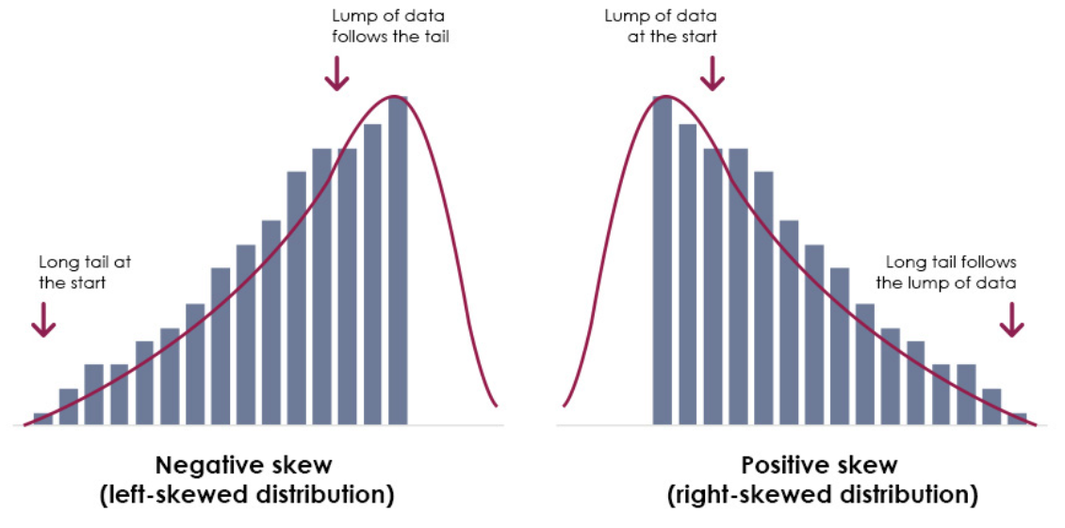
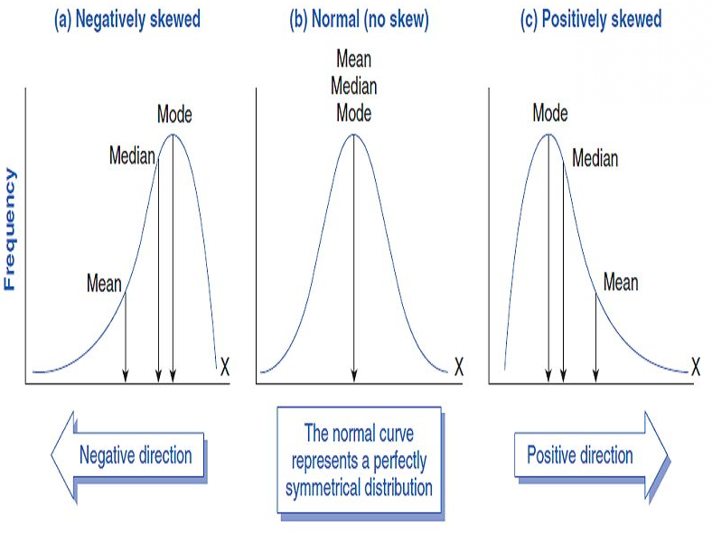
Skewness
In a normal distribution, data is symmetrically distributed with no skew.
Skewness is a measure of the asymmetry of a distribution. A distribution is asymmetrical when its left and right side are not mirror images.
A distribution can have right (or positive), left (or negative), or zero skewness.
A right-skewed distribution is longer on the right side of its peak
A left-skewed distribution is longer on the right side of its peak

Slide 46
Generally for the value of Skewness
Skewness values
If skewness is between -0.5 and 0.5 | Negligibly skewed, approximately symmetric
If skewness is between -1 and -0.5 | Negatively or left skewed | Moderately skewed
If skewness is between 0.5 and 1 | Positively or right skewed
If skewness is less than -1 or greater than 1 | Heavily or highly skewed

Slide 47
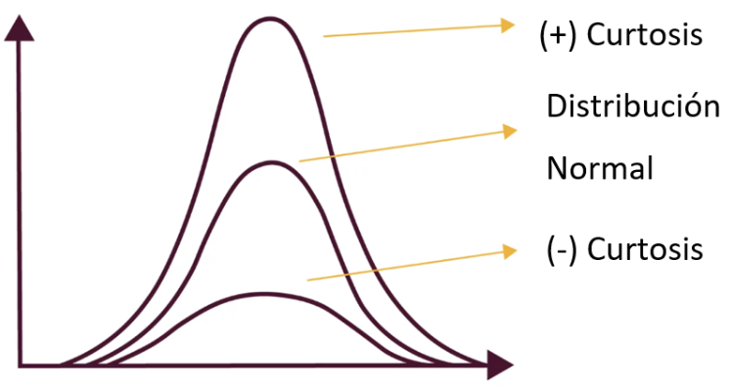
Kurtosis
Kurtosis is a statistical measure that defines how heavily the tails of a distribution differ from the tails of a normal distribution.
It helps in analysing the characteristics and outliers of a dataset.
It identifies whether the tails of a given distribution contain extreme values.
Positive kurtosis indicates heavier tails and a more peaked distribution
Negative kurtosis suggests lighter tails and a flatter distribution.

Slide 48
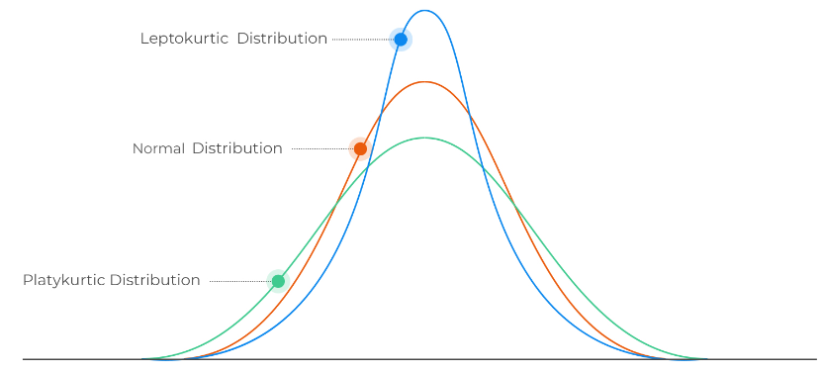
Generally, for the value of kurtosis
Kurtosis values
Mesokurtic (Normal kurtosis) | A distribution is considered mesokurtic when it has the same kurtosis as a normal distribution (which has a kurtosis of 0). This means that the distribution has a similar concentration of data points in the tails as a normal distribution.
Leptokurtic (Excess kurtosis > 0) | A distribution is leptokurtic when it has fatter tails and a higher peak than a normal distribution. This indicates that the data have more extreme values than a normal distribution.
Platykurtic (Excess kurtosis < 0) | A distribution is platykurtic when it has thinner tails and a flatter peak than a normal distribution. This implies that the data have fewer extreme values than a normal distribution.

Slide 49
  How can we define each individual point within the data set
  ?

Slide 50
z-score
Data set
95
105
112
116
133
148
155
156
231
How can we define each individual point within the data set?
We could say that there is a very big data point, or that it’s 92 points above the mean
Or we could describe its distance from the mean using the standard deviation – we refer to this as the data point’s
  z-score
Mean | 139
Median | 133
Standard Deviation | 41

Slide 51
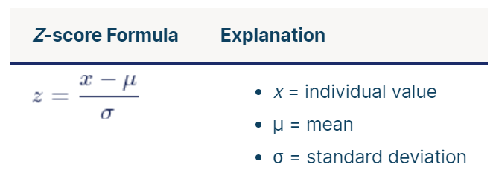
z-score
A z-score describes the position of a raw score in terms of its distance from the mean when measured in standard deviation units.
The z-score is positive if the value lies above the mean, and negative if it lies below the mean.

Slide 52
z-score – example 1
Data set
95
105
112
116
133
148
155
156
231
Mean | 139
Median | 133
Standard Deviation | 41
231 - 139
2.24 =
41

Slide 53
z-score – example 2
Data set
95
105
112
116
133
148
155
156
231
Mean | 139
Median | 133
Standard Deviation | 41
We have a negative z score as
112 < 139
112 - 139
-0.66 =
41

Slide 54
z-score – example 2
Data set
95
105
112
116
133
148
155
156
231
Mean | 139
Median | 133
Standard Deviation | 41
A distribution curve has negative and positive sides, so there are positive and negative standard deviations and z-scores. However, this has no relevance to the value itself other than indicating which side of the mean it is on. A negative value means it is on the left of the mean, and a positive value indicates it is on the right.
231 - 139
112 - 139
2.24 =
- 0.66 =
41
41
We have a positive z score as
231 > 139
We have a negative z score as
112 < 139
231 is further from the mean
112 is relatively closer to the mean

Slide 55

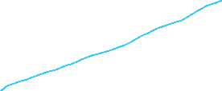

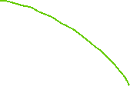

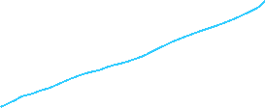




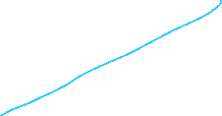




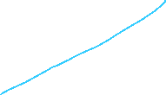



z-score [Standard Normal Distribution ]
μ = 0
σ = 1
μ = 0
The z score tells us how many standard deviations an observation is from the mean μ
So the z score 2.44 is 2.44 standards deviations for the μ
How much area that specific z score is associated with. We can find this using the z table (Standard Normal Table)
Τhe z score -0.66 is -0.66 standards deviations for the μ
2.24
-0.66
-3
-2
-1
0
1
2
2.24
3
68%
95%

Slide 56
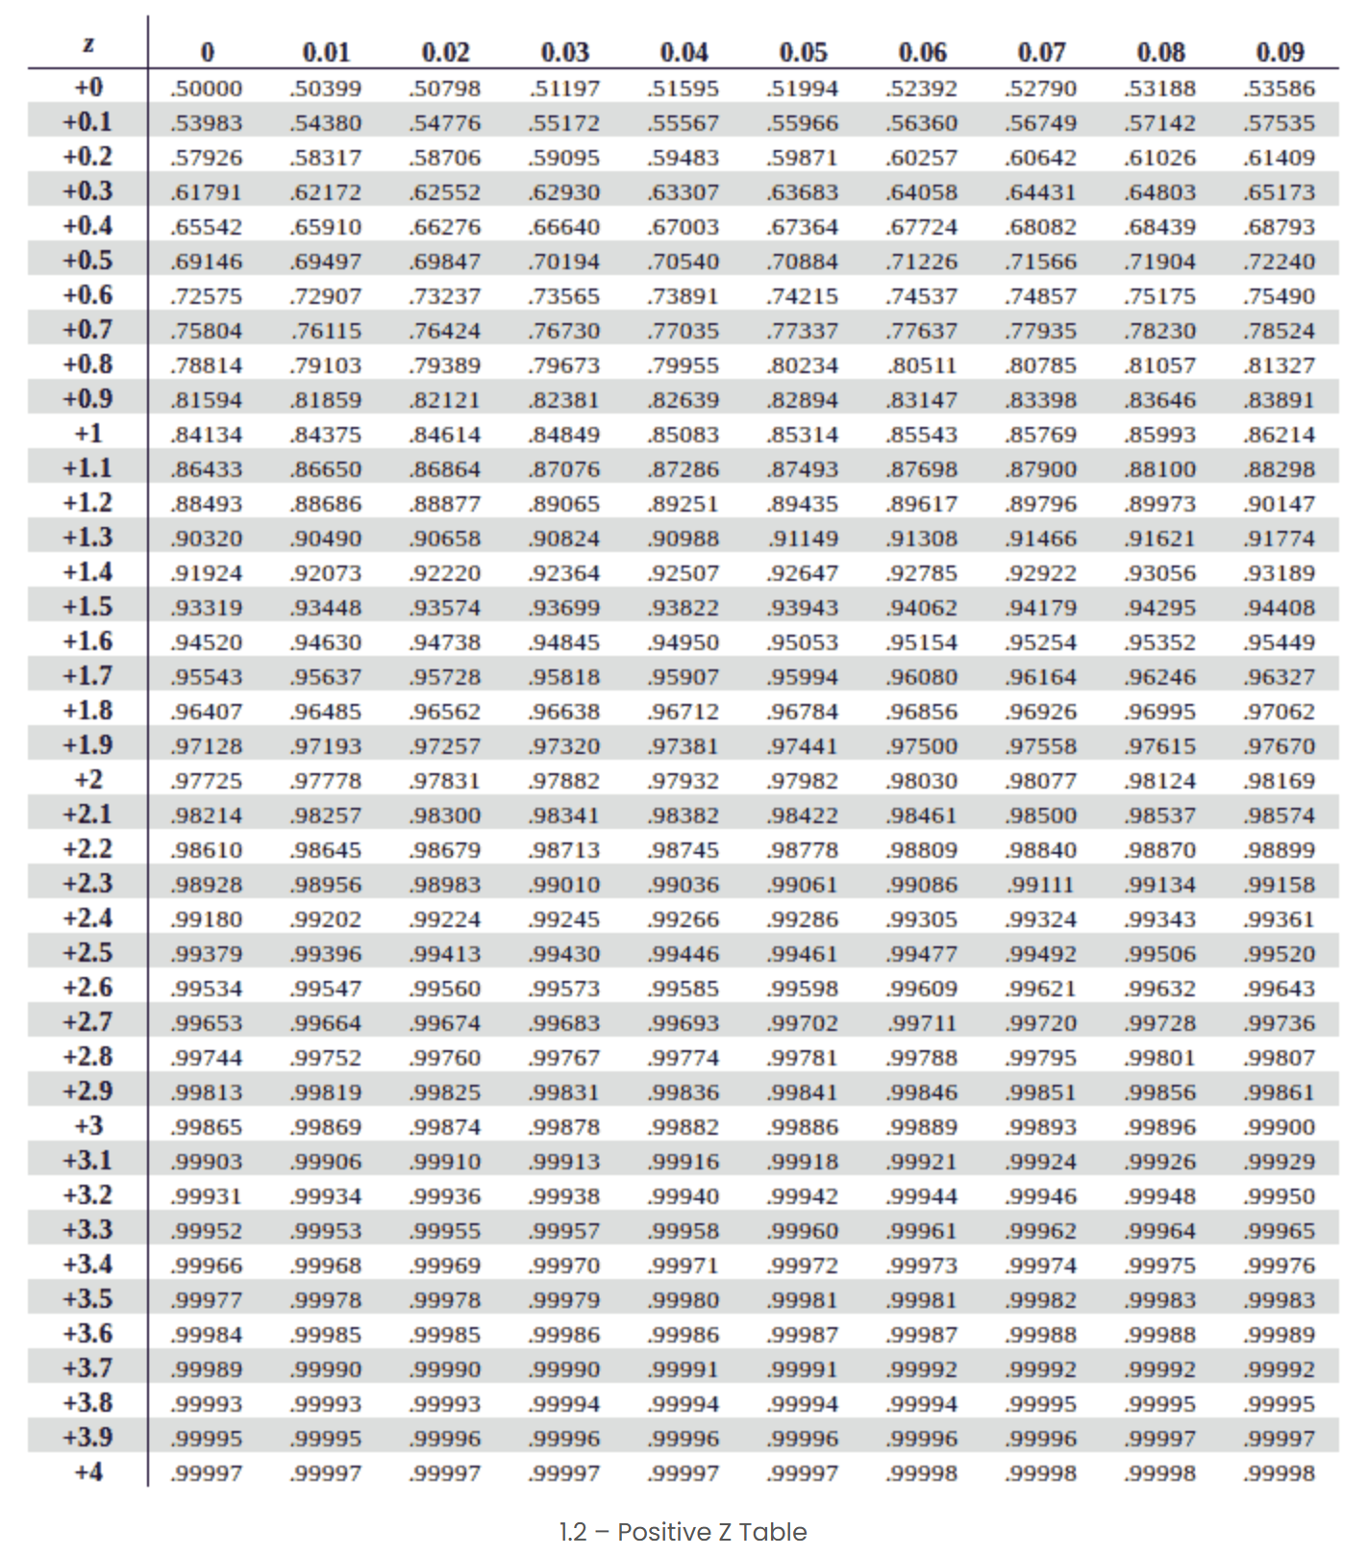


z table (Standard Normal Table)
areas
Steps:
Look up the z-score: In a standard normal distribution table, locate the area corresponding to z = 2.44.
Area to the Left: For z = 2.44, the area to the left (cumulative probability) is approximately 0.9927. This means that about 99.27% of values lie below a z-score of 2.44.
Area to the Right: If you want the area to the right of z = 2.44, subtract the cumulative area from 1:
1 − 0.9927 = 0.0073
This means that about 0.73% of values lie above a z-score of 2.44.
Summary:
Area to the Left (Cumulative): 0.9927 or 99.27%
Area to the Right: 0.0073 or 0.73%
z scores

Slide 57
z-score [Standard Normal Distribution ]
μ = 0
σ = 1
μ = 0
This means that about 0.73% of values lie above a z-score of 2.44.
Summary:
Area to the Left (Cumulative): 0.9927 or 99.27%
Area to the Right: 0.0073 or 0.73%
-3
-2
-1
0
1
2
3
Ζ = 2.24
99.27%
0.73%

Slide 58
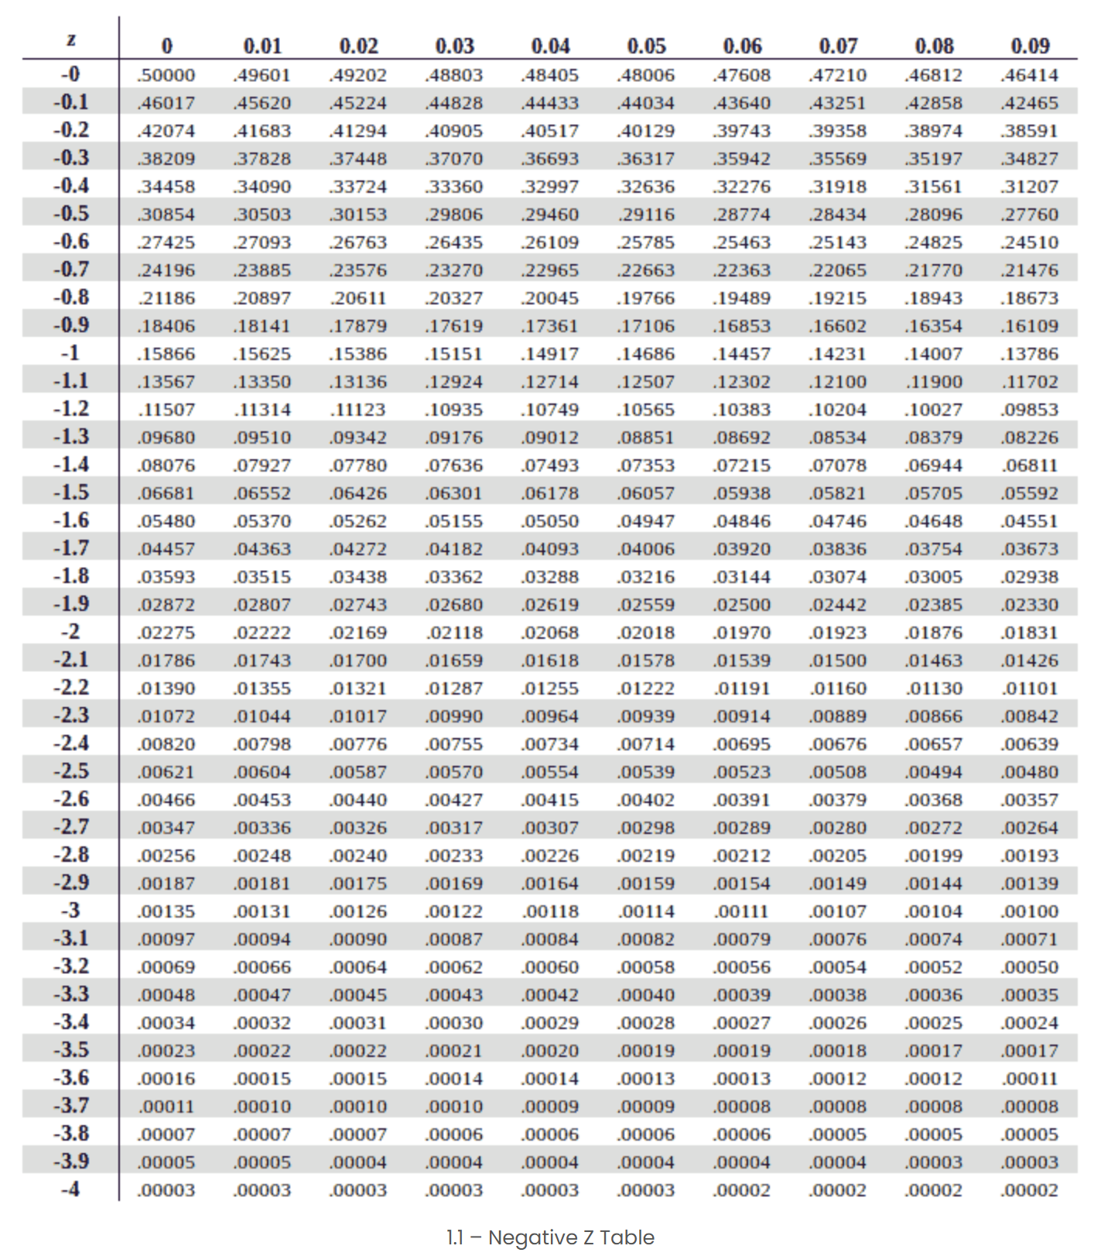

z table (Standard Normal Table)
Steps:
Look up the z-score: In a standard normal distribution table, locate the area corresponding to z = -0.66
2. For z = -0.66, the area to the left (cumulative probability) is approximately 0.2546. This means that about 25.46% of values lie below a z-score of -0.66.
3. Area to the Right
To find the area to the right of z = -0.66, subtract the cumulative area from 1:
1−0.2546=0.74541
This means that about 74.54% of values lie above a z-score of -0.66.
Summary:
Area to the Left (Cumulative): 0.2546 or 25.46%
Area to the Right: 0.7454 or 74.54%
areas
z scores

Slide 59







z-score [Standard Normal Distribution ]
μ = 0
σ = 1
μ = 0
This means that about 74.54% of values lie above a z-score of -0.66.
Summary:
Area to the Left (Cumulative): 0.2546 or 25.46%
Area to the Right: 0.7454 or 74.54%
-3
-2
-1
0
1
2
3
Ζ = -0.66
25.46%
74.54%

Slide 60
z-score or standard score
z-score also known as a standard score, gives us an idea of how far from the mean a data point is.
More technically it’s a measure of how many standard deviations below or above the population mean a raw score is.
Why is this important?
  Because it shows how individual points of a data set relate to the central tendency, how usual or unusual a data point is!!!
  This is very important when we start making inferences about the data.

Slide 61
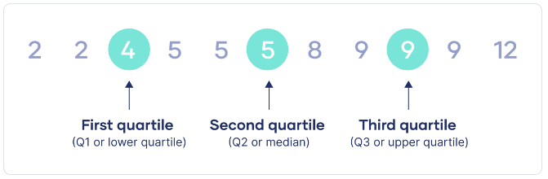
Quartiles
Quartiles are a set of descriptive statistics. They summarize the central tendency and variability of a dataset or distribution.
Quartiles divide the data into four parts, as equal as possible. For the calculation quartiles, the data must be sorted from the smallest to the largest value.
  First quartile: Also known as Q1, or the lower quartile. This is the number halfway between the lowest number and the middle number.
  Second quartile: Also known as Q2, or the median. This is the middle number halfway between the lowest number and the highest number.
  Third quartile: Also known as Q3, or the upper quartile. This is the number halfway between the middle number and the highest number.

Slide 62
Find quartiles
To find the quartiles of a dataset or sample, follow the step-by-step guide below.
  Count the number of observations in the dataset (n).
  Sort the observations from smallest to largest.
  Find the first quartile:
    Calculate n * (1 / 4).
    If n * (1 / 4) is an integer, then the first quartile is the mean of the numbers at positions n * (1 / 4) and n * (1 / 4) + 1.
    If n * (1 / 4) is not an integer, then round it up. The number at this position is the first quartile.
  Find the second quartile:
    Calculate n * (2 / 4).
    If n * (2 / 4) is an integer, then the first quartile is the mean of the numbers at positions n * (2 / 4) and n * (2 / 4) + 1.
    If n * (2 / 4) is not an integer, then round it up. The number at this position is the second quartile.
  Find the third quartile:
    Calculate n * (3 / 4).
    If n * (3 / 4) is an integer, then the first quartile is the mean of the numbers at positions n * (3 / 4) and n * (3 / 4) + 1.
    If n * (3 / 4) is not an integer, then round it up. The number at this position is the third quartile.

Slide 63
Example
Imagine you conducted a small study to find the number of errors users do while interacting with a UI. You want to report the quartiles of the errors.
Step 1: Count the number of observations in the dataset
  n = 2 + 3 + 4 + 1 + 2 + 2 = 14
Errors | 1 | 2 | 3 | 4 | 5 | 6
Frequency | 2 | 3 | 4 | 1 | 2 | 2

Slide 64
Example
Imagine you conducted a small study to find the number of errors users do while interacting with a UI. You want to report the quartiles of the errors.
Step 2: Sort the observations in increasing order
  1, 1, 2, 2, 2, 3, 3, 3, 3, 4, 5, 5, 6, 6
Errors | 1 | 2 | 3 | 4 | 5 | 6
Frequency | 2 | 3 | 4 | 1 | 2 | 2

Slide 65
Example
Imagine you conducted a small study to find the number of errors users do while interacting with a UI. You want to report the quartiles of the errors.
Step 3: Find the first quartile
  n * (1 / 4) = 14 * (1 / 4) = 3.5
  3.5 is not an integer, so Q1 is the number at position 4.
  1, 1, 2, 2, 2, 3, 3, 3, 3, 4, 5, 5, 6, 6
  Q1 = 2 errors
Errors | 1 | 2 | 3 | 4 | 5 | 6
Frequency | 2 | 3 | 4 | 1 | 2 | 2

Slide 66
Example
Imagine you conducted a small study to find the number of errors users do while interacting with a UI. You want to report the quartiles of the errors.
Step 4: Find the second quartile
  n * (2 / 4) = 14 * (2 / 4) = 7
  7 is an integer, so Q2 is the mean of the numbers at positions 7 and 8.
  1, 1, 2, 2, 2, 3, 3, 3, 3, 4, 5, 5, 6, 6
  Q2 = (3 + 3) / 2
  Q2 = 3 errors
Errors | 1 | 2 | 3 | 4 | 5 | 6
Frequency | 2 | 3 | 4 | 1 | 2 | 2

Slide 67
Example
Imagine you conducted a small study to find the number of errors users do while interacting with a UI. You want to report the quartiles of the errors.
Step 5: Find the third quartile
  n * (3 / 4) = 14 * (3 / 4) = 10.5
  10.5 is not an integer, so Q3 is the number at position 11.
  1, 1, 2, 2, 2, 3, 3, 3, 3, 4, 5, 5, 6, 6
  Q3 = 5 errors
Errors | 1 | 2 | 3 | 4 | 5 | 6
Frequency | 2 | 3 | 4 | 1 | 2 | 2

Slide 68
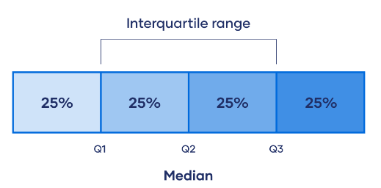
Measures of Variability/Interquartile range
In descriptive statistics, the interquartile range tells you the spread of the middle half of your distribution.
Quartiles segment any distribution that’s ordered from low to high into four equal parts. The interquartile range (IQR) contains the second and third quartiles, or the middle half of your data set.
The interquartile range is the best measure of variability for skewed distributions or data sets with outliers. Because it’s based on values that come from the middle half of the distribution, it’s unlikely to be influenced by outliers.

Slide 69
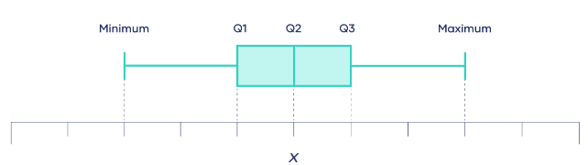
Visualise the quartiles with boxplots
To make a boxplot, you first need to calculate the five-number summary:
The minimum
This is the lowest observation. If you order the numbers in your dataset from lowest to highest, the minimum is the first number. The minimum is sometimes called the zeroth quantile.
The first quartile
The second quartile
The third quartile
The maximum
This is the highest observation. If you order the numbers in your dataset from lowest to highest, the maximum is the last number. The maximum is sometimes called the fourth quantile.

Slide 70
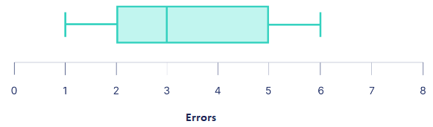
Visualise the quartiles with boxplots
Errors example
  Q1 = 2 errors
  Q2 = 3 errors
  Q3 = 5 errors
Errors | 1 | 2 | 3 | 4 | 5 | 6
Frequency | 2 | 3 | 4 | 1 | 2 | 2
Q1
Q2
Q3

Slide 71
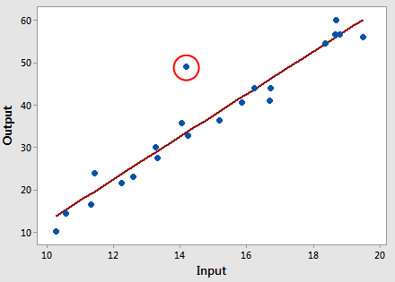
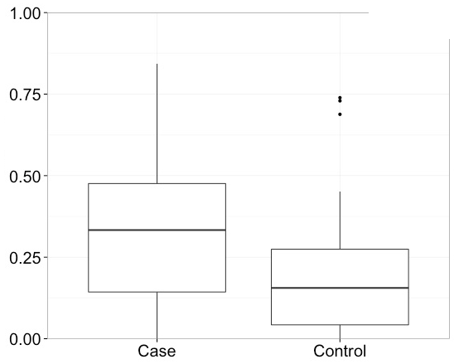
Outliers
A value that "lies outside" (is much smaller or larger than) most of the other values in a set of data, that it has an abnormal distance from the other values in the data set.
  For example, in the scores: 25,29,3,32,85,33,27,28 both 3 and 85 are "outliers".
If a value has a high enough or low enough
  z score, it can be considered an outlier. As a rule of thumb, values with a z score greater than 3 or less than –3 are often determined to be outliers.
It is up to the analyst (or a consensus process) to decide what will be considered abnormal.

Slide 72
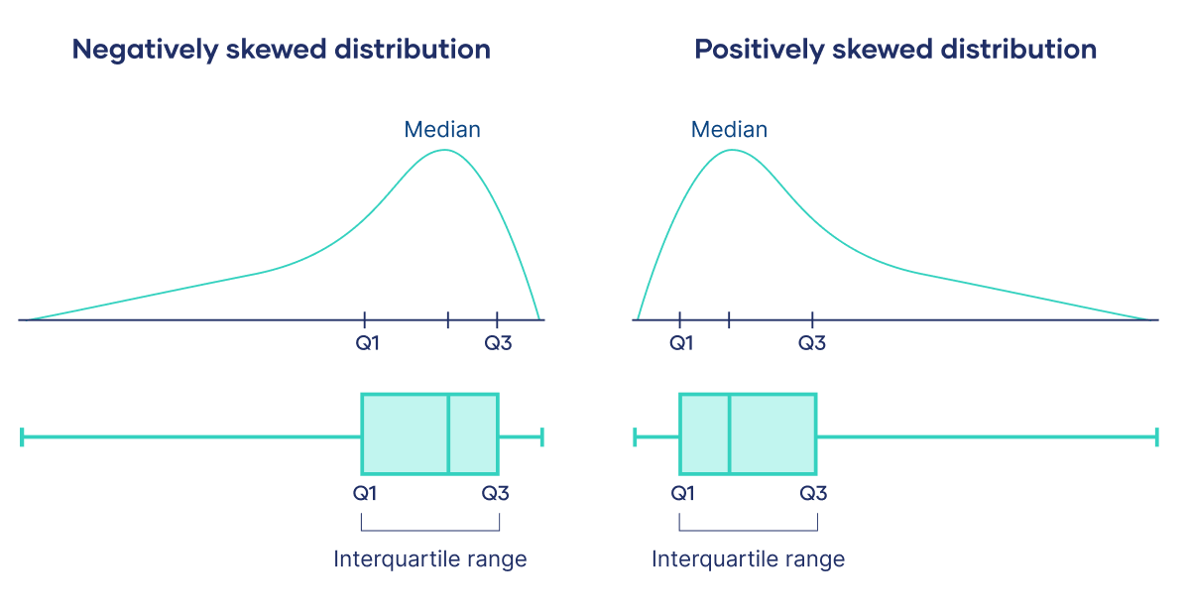
Interquartile range (IQR)—
The distance between the first and third quartiles — the interquartile range (IQR) — is a measure of variability. It indicates the spread of the middle 50% of the data.
  IQR = Q3 − Q1
The IQR is a good measure of variability for skewed distributions or distributions with outliers.
The distance between quartiles can give you a hint about whether a distribution is skewed or symmetrical.

Slide 73
Quartiles
Quartiles are values that split sorted data or a probability distribution into equal parts.
In general terms, a q-quantile divides sorted data into q parts.
The most commonly used quantiles have special names:
  Quartiles (4-quantiles): Three quartiles split the data into four parts.
  Deciles (10-quantiles): Nine deciles split the data into 10 parts.
  Percentiles (100-quantiles): 99 percentiles split the data into 100 parts.

Slide 74
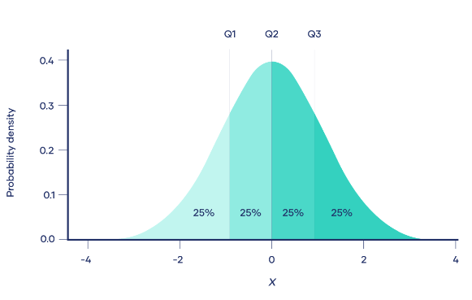
Percentile
Quartiles are a type of percentile. A percentile is a value with a certain percentage of the data falling below it.
  The first quartile (Q1, or the lowest quartile) is the 25th percentile, meaning that 25% of the data falls below the first quartile.
  The second quartile (Q2, or the median) is the 50th percentile, meaning that 50% of the data falls below the second quartile.
  The third quartile (Q3, or the upper quartile) is the 75th percentile, meaning that 75% of the data falls below the third quartile.

Slide 75
What measures of central tendency to use?
The measures of central tendency you can use depends on the level of measurement of your data.
 | Mean [the average of a data set] | Median [the middle] | Mode [the most frequent value]
Nominal |  |  | ✓
Ordinal or ranked data |  | ✓ | ✓
Interval, ratio | ✓ | ✓ | ✓

Slide 76
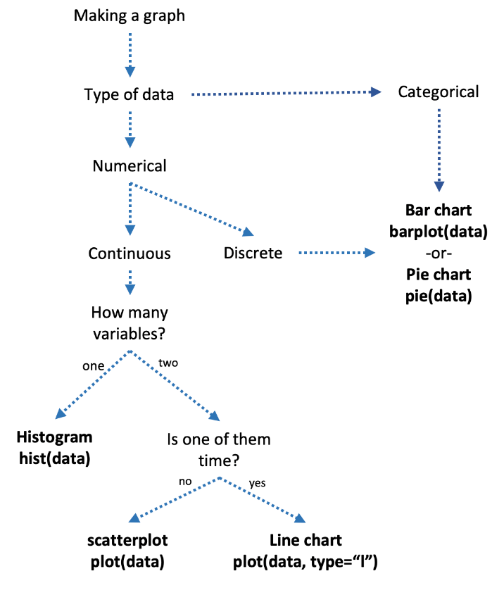
What graph do we plot?
Name | Type | Appearance | Examples
Discrete | Numeric | Integers | pairs of shoes, books owned, children
Continuous | Numeric | Decimals | Time spent, speed, weight
Nominal | Categorical | Words no order | Race, shoe color, car type
Ordinal | Categorical | Words with order | Education, happiness

Slide 77


Summary - statistical analysis
Descriptive statistics
Summary measures
sample
Sampling
Inferential statistics
Prediction
Model
population

Slide 78
Summary
We covered
  Descriptive statistics concepts
    Data types
    Studying the mean
    Measures of Central Tendency
    Measures of Variability/Spread
    Normal distribution
    Standard deviation
  Graphs
Next week (week 8) we will continue with into to inferential statistics

Slide 79
Test your understanding
What is the population, sample, parameters and statistics
How do we prepare the data for statistical analysis?
What type of variable types we have
What are the possible data types we may collect: qualitative, quantitative, categorical, discrete, continuous (nominal, ordinal, interval, ratio)
What are the measures of central tendency?
How do we measure Central Tendency (mean, median, mode)
Which measures of central tendency can I use?
What is variability?
What are the 4 main measures of variability?
How do we measure Measures of Variability/Spread
What is the difference between central tendency and variability?
What is the Normal Distribution
What is the difference between range and interquartile range?
When should I use interquartile range?
What is Skewness
What Graphs are appropriate depending on the data and the experimental design
What is the difference between descriptive and inferential statistics?

Slide 80
Reading
Lazar, J. et al. (2017) Research methods in human-computer interaction. Second edition. Cambridge, Massachusetts: Morgan Kaufmann Publishers.
  Chapter 4. Statistical analysis
Tullis, T. (Thomas) et al. (2013) Measuring the user experience : collecting, analyzing, and presenting usability metrics. 2nd ed. Amsterdam, Netherlands: Elsevier.
  Chapter 2 Background (data)
Online Resources
Bhandari, P. (June 9, 2022). Central Tendency | Understanding the Mean, Median & Mode. Scribbr. Retrieved October 21, 2022, from https://www.scribbr.com/statistics/central-tendency/
Bhandari, P. (September 2, 2022). Variability | Calculating Range, IQR, Variance, Standard Deviation. Scribbr. Retrieved October 23, 2022, from https://www.scribbr.com/statistics/variability/
Bhandari, P. (May 25, 2022). How to Calculate Standard Deviation (Guide) | Formulas & Examples. Scribbr. Retrieved October 23, 2022, from https://www.scribbr.com/statistics/standard-deviation/
Turney, S. (2022, June 17). Quartiles & Quantiles | Definition, Calculation & Interpretation. Scribbr. Retrieved November 3, 2022, from https://www.scribbr.com/statistics/quartiles-quantiles/
Bhandari, P. (2022, July 06). Normal Distribution | Examples, Formulas, & Uses. Scribbr. Retrieved November 6, 2022, from https://www.scribbr.com/statistics/normal-distribution/

